Slide 1
Pharmacy Best Thomas Bisset
6:30 Buffet & networking
7:00 Introductions
7:05 Community Pharmacy Engagement Project: Improving Communication between pharmacies and surgeries
7:55 Thinking Pharmacy First: Making the most of the opportunities in National and Locally commissioned services
8:40 Questions
Pharmacy BEST
January 2024
Prior Campus

Slide 2
Housekeeping
Introductions
Fire Alarms
Telephone
Toilets
Questions

Slide 4
Pharmacy BEST: Aims & Objectives
Barnsley Education Support & Training
Best.barnsleyccg.nhs.uk
Help Pharmacies deliver quality services
Align with CCG plans
Help Barnsley patients access healthcare in the appropriate place, at the appropriate time from the appropriate person

Slide 5
BEST website
https://best.barnsleyccg.nhs.uk

Slide 6
Barnsley Community Pharmacy and General Practice Collaborative Working Update
Chris Lawson, Richard Daniszewski and Laura White
NHS SY ICB/PCN Barnsley Place Medicines Optimisation Team
Wednesday 31st January 2024

Slide 7
What Have we Done in the Last 12 Months…
Team Across Primary Care including Community Pharmacists, GP Staff, ICB/PCN Clinical Pharmacy Staff took part in NHS Northeast and Yorkshire Leadership Academy (NEYLA) “Leadership for Integrated Care” Programme
Programme looked at overcoming Developing Ways of Working and Overcoming Challenges in/across Systems
Community Pharmacy (CP) and General Practice (GP) F2F Engagement and Integration (E&I) Events took place May, July and November 2023
E&I Events Attended by CP,GP colleagues and ICB/PCN Meds Opt Team Members- Looking at Priority Areas to Work On

Slide 8
What Have We Done In the Last 12 Months(2)
From the Leadership and E&I Events, 5 Priority Themes Identified:
GP/CP Communications
Out of Stocks (OOS) Issues
CPCS/Pharmacy First
Hypertension Case Finding Service
Eclipse Protect trial in CP
Subsequent set-up of T&F groups for each Priority

Slide 9
NHS NEYLA Primary Care Collaborative
Jan-May 2024- Team Across Barnsley Primary Care Taking Part in a Series of Learning Sessions and Co-Labs Looking at How We can:
Improve Engagement between CP and GP
Improve Communication between CP and GP
Improve Collaboration between CP and GP
Looking at: What Now? Near Future? What’s Over The Hill?
Priorities for Near Future We are Focussing On:
CP/GP Engagement and Communications and Pharmacy First

Slide 10
Communication with Clinical Pharmacy teams
2 Way Relationship
Work out what works best for your team/clinical pharmacy team/ surgery
Make life easier:
Nomads,
Out of stocks

Slide 11
Communication with Clinical Pharmacy teams
Integration between community pharmacy and general practice is key
One goal between all; PATIENTS
Develop relationships → Joined up Approach
Mutual trust and understanding
Regular contact → Stronger relationships

Slide 12
CP and GP Communications Pilot
Recognition that Communications between CP and GP can be Challenging and Out of Stocks is A Big Issue for Both
2 of 5 Main Workstreams Identified by Barnsley CP and GP Engagement and Integration Work
We need to find ways of Improving this
NHS Mail- is used by CP and GP
We know IT solutions are on the way….
BUT… There is an Opportunity to build on this collaborative work -Act Now !

Slide 13
CP and GP Communications Pilot
EoI from Lo’s Pharmacy and Ashville Medical Practice to scope out
NHS Mail to be used to Send Queries- Marked as URGENT or ROUTINE with Nature of Query (e.g. OOS) plus pat. NHS number
Email to incl. NHS Number, Pat. Name, Address and DOB
URGENT- to be assigned to Duty Doctor for action that day. Followed up with phone call to bypass number within 2-3 hours esp. if late in the day
ROUTINE- will be looked at through normal processes and seen by a GP/appropriate HCP within 48 hours

Slide 14
CP and GP Communications Pilot
Queries to GP Practice from Pharmacy NHS Mail Account
re OOS- clear statement of what is OOS
Suggestion of alternatives where possible e.g. diff. pack sizes, formulations, strengths, drugs in same therapeutic class
Keep info shared in bullet points
Where action required- be clear and explicit with timescale for action
Sign off email with most appropriate contact in the pharmacy
Pilot between Lo’s Oaks Park and Ashville went live 29/01/2024
Review after 4 weeks and share learning across Barnsley CPs and GPs

Slide 15
Pharmacy First-Barnsley Support
NHS Barnsley ICB/PCN Meds Optimisation Team (working with ICB/LPC) Contacting:
-All Barnsley CP
-All Barnsley GP
To determine Readiness, Awareness and Plans re Pharmacy First
Once information received back centrally:
Team Will Analyse the Info- Set up on Central Spreadsheets
Facilitate Contact and Collaboration between CP and GP
Share Info with CPSY and NHS SY ICB CP Clinical Lead
CPSY working with CP/GP on Referral Processes

Slide 16
Points to Consider…
Have you spoken ( or have a plan) to your Local GPs re Pharmacy First Launch?
Some CP have liaised with GP- Advising initial referrals for Clinical Pathway-Uncomplicated UTI only
Have you agreed local process re: Referrals/Escalation?
GP- Should Refer Patients NOT Signpost to Facilitate CP Workflow
Check GP knows CPCS will continue part of Pharmacy First
Currently, NHS Referral Outcomes will come via NHS Mail as for CPCS
Speak to your GPs re GP Connect-Once Testing Complete- Referral Outcomes Info Will Arrive into Workflow AND Clinical Record

Slide 17
Points To Consider….
Has the GP Practice Got A Copy of CPCS/Pharmacy First-Referral Tool?
Tailor the Referral Tool to Locally Agreed Pharmacy and GP Practice Conditions
Develop an Agreement of How the Service Will work incl. Escalations and Referrals
Work together to Develop Key Information for Pharmacy Staff
Work Together to Develop Key Information for GP Practice Staff
Briefing Document for GP Practices: We’re all community pharmacy (cpe.org.uk)
GP webinar on Thursday 1st Feb 5-6pm: General Practice Webinar NHS England Events will be covering Pharmacy First
If GP Practices need support setting up referrals into Pharmacy First discussing referral options contact: laura.richardson42@nhs.net

Slide 18
Thinking Pharmacy First
Making the most of the opportunities in National and Locally commissioned services

Slide 19
Delivery Plan for Recovering Access to Primary Care
.
On 9th May 2023, NHSE and DHSC published the Delivery Plan for recovering access to primary care.
The plan includes a commitment to:
Commission community pharmacies to deliver a Pharmacy First service by enabling the supply of NHS medicines for seven conditions and
Increase provision of the community pharmacy NHS Pharmacy Contraception Service and the Blood Pressure Checks Service.
Invest to significantly improve the digital infrastructure between general practice and community pharmacy.
Community Pharmacy Working across layers of scale
Notes:
Self Referral -

Slide 20
Service Launch Dates
After successful negotiations between Community Pharmacy England, NHSE and DHSC, agreed to:
.
Launch Pharmacy First on 31 January 2024, subject to the appropriate digital systems being in place to support these services
Launch expansion of Pharmacy Contraception Service on
1 December 2023
Relaunch Blood Pressure Check Service on
1 December 2023
Community Pharmacy Working across layers of scale
Supporting women to have easier access to contraception, through:
Additional funding
Greater use of pharmacy team skill mix
Encouraging contractors to sign up
Both ongoing supply and initiation of supply will be combined into one service.
NHS website postcode search tool enable patients to find local pharmacies who deliver the contraception service.
Blood pressure checks to help identify the 5.5 million people with undiagnosed blood pressure at risk of heart attack and stroke, through:
Additional funding
Greater use of pharmacy team skill mix
Encouraging contractors not signed up to do so
Encouraging contractors who have signed up to see more patients and completion of more ABPMs
Notes:
Self Referral -

Slide 21
Pharmacy First
Pharmacy First will be a new advanced service that will include 7 new clinical pathways and will replace the Community Pharmacist Consultation Service (CPCS).
This means the full service will consist of three elements:
Pharmacy First (clinical pathways)
Pharmacy First (urgent repeat medicine supply)
Pharmacy First (NHS referrals for minor illness)
new element
previously commissioned as the CPCS
previously commissioned as the CPCS
Community Pharmacy Working across layers of scale
Contractors will need to be able to provide all 3 elements (only exception is DSPs will not need to do otitis media pathway due to need to use otoscopes).
Remote consultations for 6 of the 7 clinical pathways are permissible via high quality video and if clinically appropriate speed of access to medicines can be facilitated.
NHSE will closely monitor the service post-launch to allow for oversight and monitor for any poyential impact on antimicrobial resistance so that any mitigations can be quickly actioned
NHSE are working with NHSBSA to enable pharmacy reimbursement and functionality for PGD supply to be recorded via ePACT2 data, or in a parallel dashboard
NIHR will commission an evaluation of Pharmacy First services considering implications for antimicrobial resistance
Notes:
Self Referral -

Slide 22
Pharmacy First Service Overview
Clinical Pathway | Age range
Uncomplicated UTI Shingles Impetigo Infected Insect Bites Sinusitis Sore Throat Acute Otitis Media | Women 16-64 18 years and over 1 year and over 1 year and over 12 years and over 5 years and over 1 to 17 years
Referral
Patient presents to the pharmacy
Urgent repeat meds referral
Minor illness referral
Gateway met
Clinical pathway referral
Gateway met
Community Pharmacy Working across layers of scale
Gateway not met
Gateway not met
Urgent repeat meds consultation
Minor illness consultation
Clinical pathway consultation
Self-care essential service
A more detailed service pathway diagram can be found in Annex A of the service specification
Notes:
Self Referral -

Slide 23
Development of Clinical Pathways
Multi-professional expert working group to develop robust clinical pathways
Clinical pathways approach
Adherence to NICE guidelines
National template for Patient Group Directions and protocols developed by SPS
AMR Programme Board Oversight
Pharmacy Quality Scheme antimicrobial stewardship foundation
National Medical Director & Chief Medical Officer for England approval
Community Pharmacy Working across layers of scale
Notes:
Self Referral -

Slide 24
Clinical Pathway Consultations
The clinical pathways element will enable the management of common infections by community pharmacies through offering self-care,safety netting advice and only if appropriate, supplying over the counter and prescription only medicines via Patient group directions
Community Pharmacy Working across layers of scale
Notes:
Self Referral -

Slide 25
Gateway point for Clinical Pathways
Consultations will only be considered as clinical pathway consultations if they successfully pass through a gateway point for each respective clinical pathway.
The gateway point ensures that the patient:
Is suitable for management within one of the seven clinical pathways
Presents relevant signs and symptoms
Does not exhibit indications of a more serious medical condition.
Only consultations that pass the gateway point will be eligible for service payments
Community Pharmacy Working across layers of scale
Notes:
Self Referral -

Slide 26
Summary of digital deliverables
Significantly improve the digital infrastructure between general practice and community pharmacy to support this expansion by:
Signpost public to support channel shifting of patients to pharmacy
(Update DOS, Profile Manager, nhs.uk and 111 online to support channel shifting of patients to pharmacy)
Integrate digital referrals from GP to pharmacy
(Bookings and Referrals Standard)
Provide pharmacists greater access to patient’s GP record
(GP Connect Access Record)
Community Pharmacy Working across layers of scale
Develop and onboard suppliers to the Digital Service for Integrated Care to ensure solutions are assured and meet user requirements and NHS standards
Capability to update the patient’s GP record following a pharmacy consultation
(GP Connect Update Record)
Support efficient renumeration and national reporting to NHS BSA
(Develop a Payment & Data API)
Notes:
Self Referral -

Slide 27
Updating the GP record
Community Pharmacy Working across layers of scale
Notes:
Self Referral -

Slide 28
Benefits
Community Pharmacy Working across layers of scale
NB Update Record will not be used to communicate urgent information (eg safeguarding) or actions for the GP – usual channels of communication will be used
Currently documents cannot be attached to messages – ABPM reports will
come by email
Notes:
Self Referral -

Slide 29
Raising awareness across South Yorkshire ICB and beyond
SY ICB / Pharmacy Forum / CPSY
Place Leads
LMCs
Pharmacy Contractors
Healthwatch
GP Practice Teams
Public & patients
Community Pharmacy Working across layers of scale
Notes:
Self Referral -

Slide 30
Resources
cpe.org.uk/national-pharmacy-services/advanced-services/pharmacy-first-service/

Slide 31
Resources
cppe.ac.uk

Slide 32
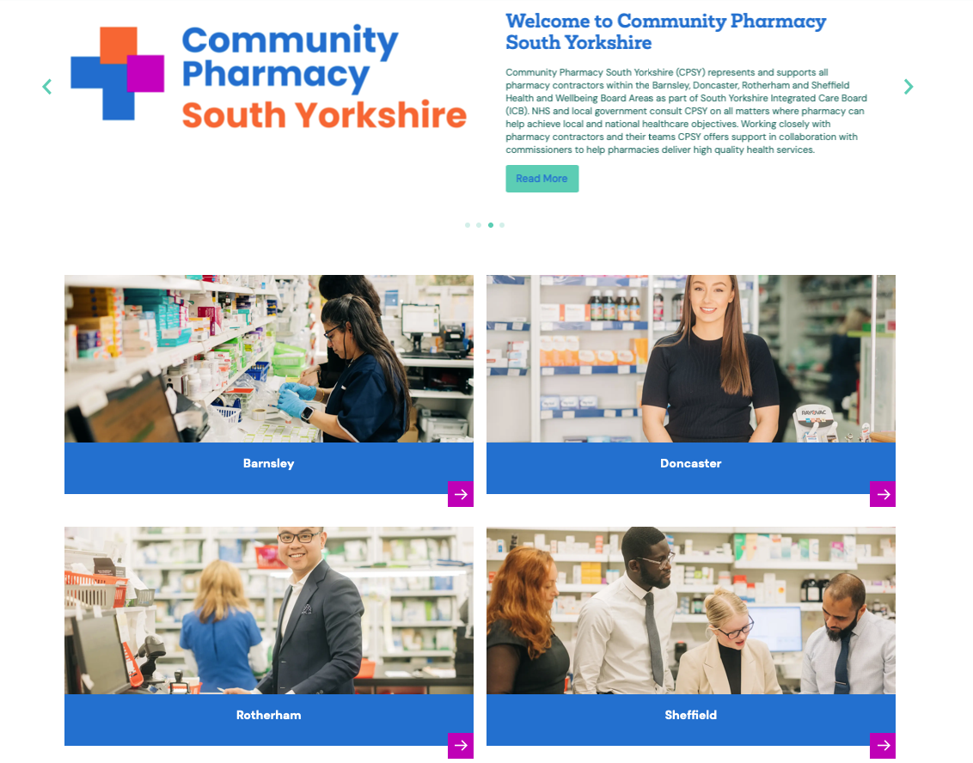
Resources
southyorkshire.communitypharmacy.org.uk

Slide 33
CPPE Pharmacy First ENT Clinical Assessment Skills Workshop
Sunday 10th March 2024, Tankersley Manor, Barnsley S75 3DQ
Morning Session (9.30am - 12.45pm)
Afternoon Session (1.45pm - 5pm)
Pharmacy First Drop in Clinics
Thursdays Throughout February
1pm to 2pm and
7pm to 8pm
southyorkshire.communitypharmacy.org.uk

Slide 34
Questions?

